Slide 1
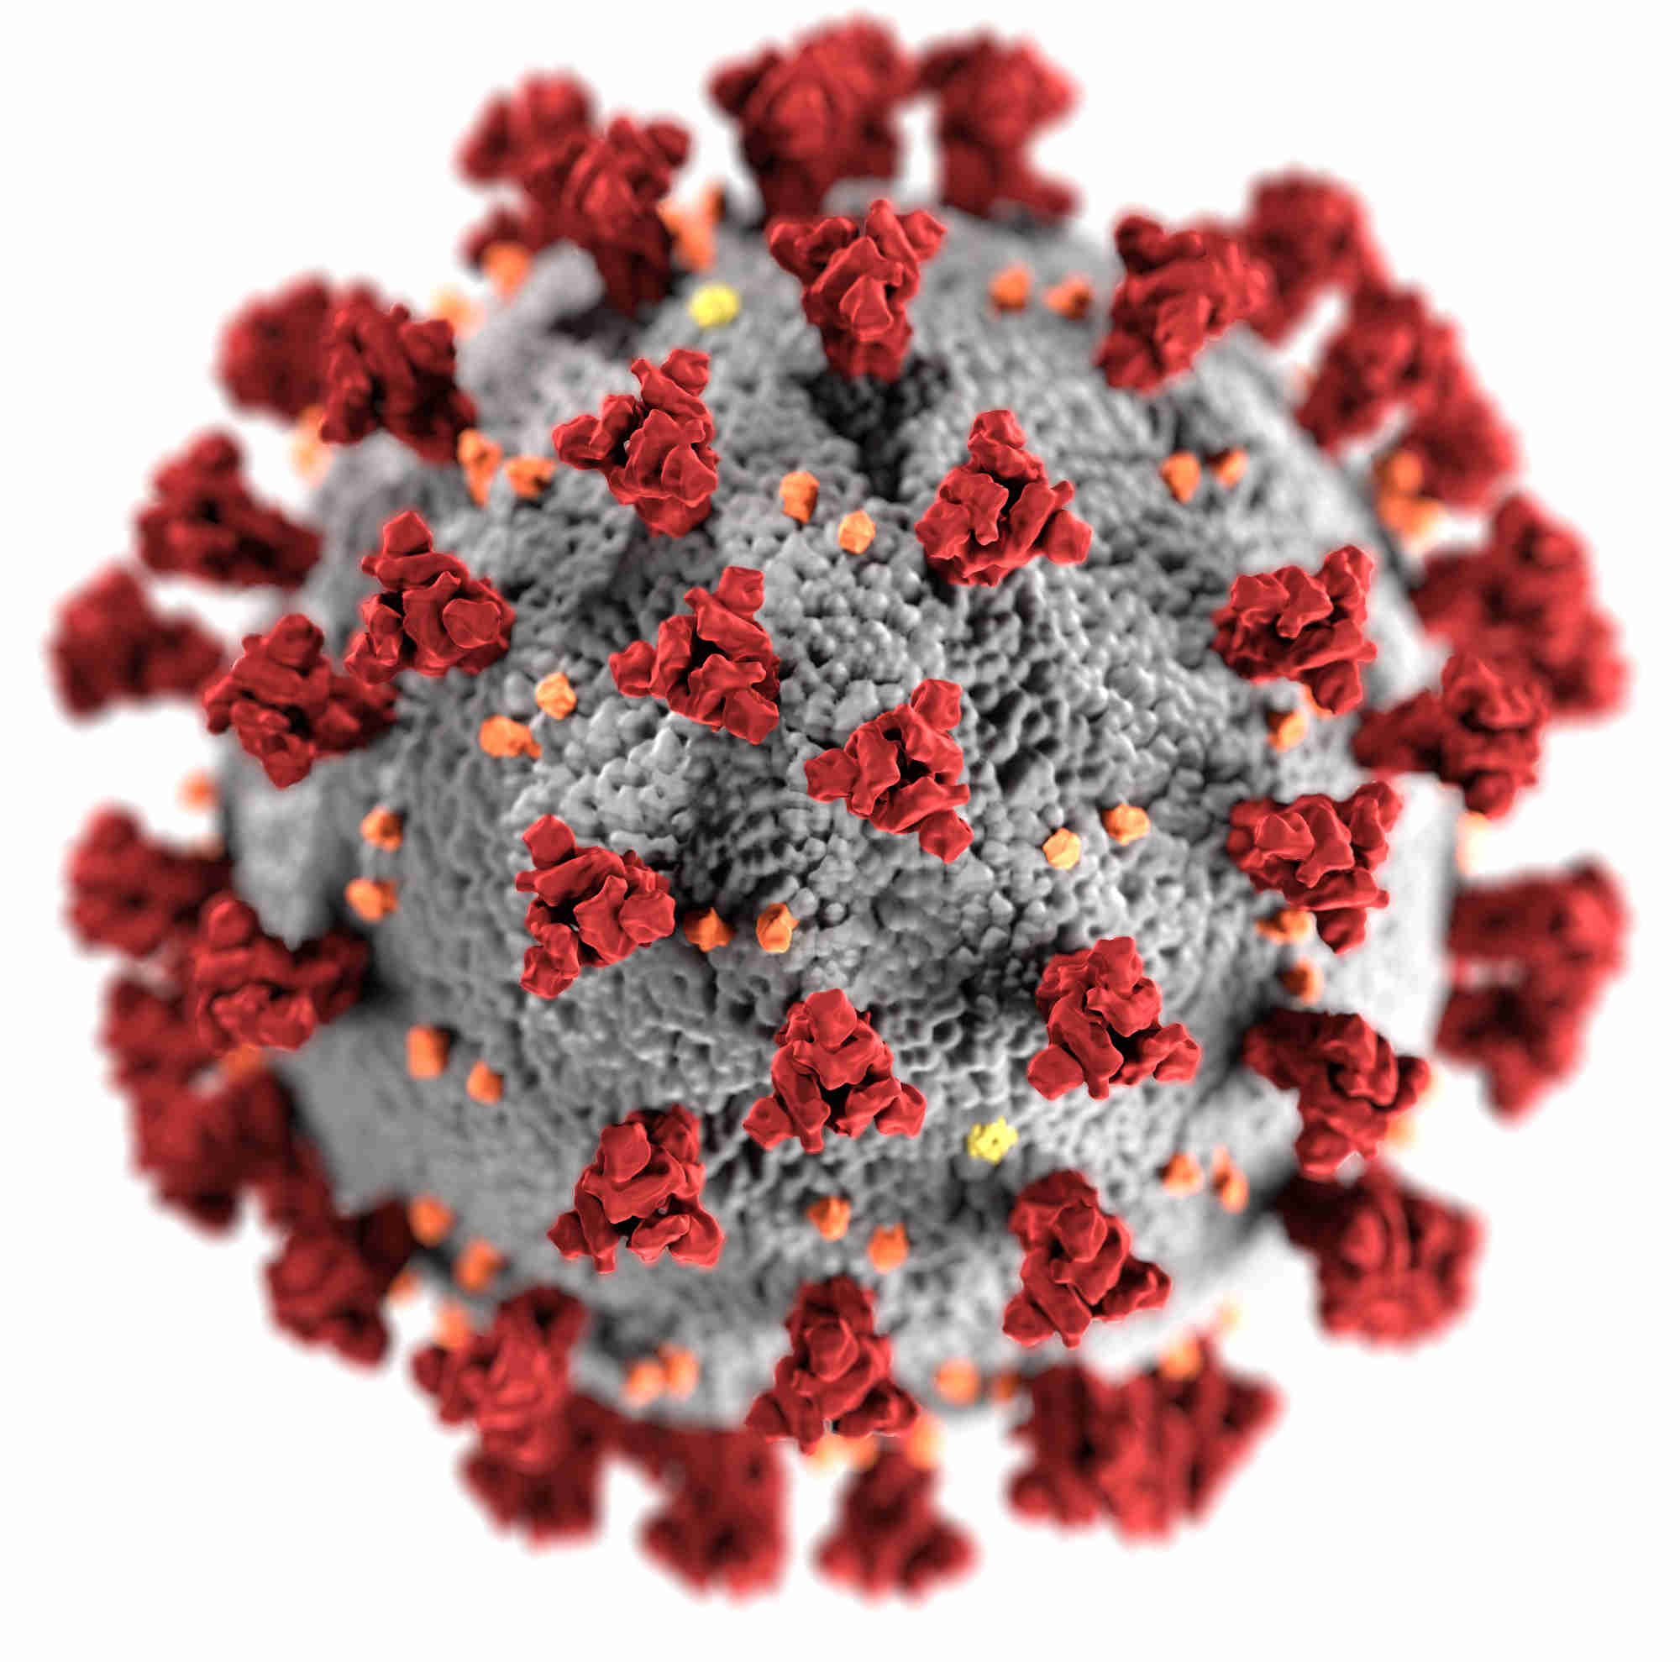
COVID-19 IN MALAYSIA-DEATH STATES
Presented By: Vadije Vishishta 2203A52186 To: Ramesh Dadi Faculty of STATML
This Photo by Unknown Author is licensed under CC BY

Slide 2
Problem statement: Develop a project to find out the death population during Covid-19 in Malaysia.
This data set contains 10 states death records and this information is collected from the Malaysia country. This "Dataset" is a class label used to divide groups int0 19,681 columns and 11 rows i.e
Date,state,deaths_new,deaths_bid,deaths_new_dod,deaths_bid_dod,deaths_unvax,deaths_pvax,deaths_fvax,deaths_boost,deaths_tat.

Slide 3
ABOUT COVID-19 IN MALAYSIA
The COVID-19 pandemic in Malaysia was a part of the ongoing worldwide pandemic of coronavirus disease 2019 (COVID-19) caused by severe acute respiratory syndrome coronavirus 2 (SARS-CoV-2). As of 10 February 2023, with over 5 million confirmed COVID-19 cases, a high of approximately 323,000 active cases, nearly 40,000 deaths, and over 66 million tests, the country is currently ranked third in the number of COVID-19 cases in Southeast Asia behind Vietnam and Indonesia, and fourth in the number of COVID-19 deaths in Southeast Asia behind Indonesia, the Philippines, and Vietnam.

Slide 4
Introduction to Machine Learning
Introduction to Machine Learning Models.
Machine learning is a subset of artificial intelligence (AI) that focuses on the development of algorithms and statistical models that enable computers to improve their performance on a specific task through experience, without being explicitly programmed. Machine learning models are the heart of this field, as they are responsible for making predictions, classifying data, and identifying patterns in data . Here's an overview of machine learning models and their key concepts: 1. Types of Machine Learning Models:
Supervised Learning: In supervised learning, the model is trained on a labeled dataset, where the input data is paired with corresponding output labels. The model learns to map inputs to outputs and can then make predictions on new, unseen data. Unsupervised Learning: Unsupervised learning involves finding patterns and structures in data without labeled outputs. Common techniques include clustering, where the goal is to group similar data points together, and dimensionality reduction, which simplifies complex data while preserving important information. Reinforcement Learning: In reinforcement learning, an agent learns to make decisions by interacting with an environment. The agent receives rewards or penalties based on its actions and learns to maximize cumulative rewards over time.

Slide 5

Introduction to Machine Learning

Slide 6
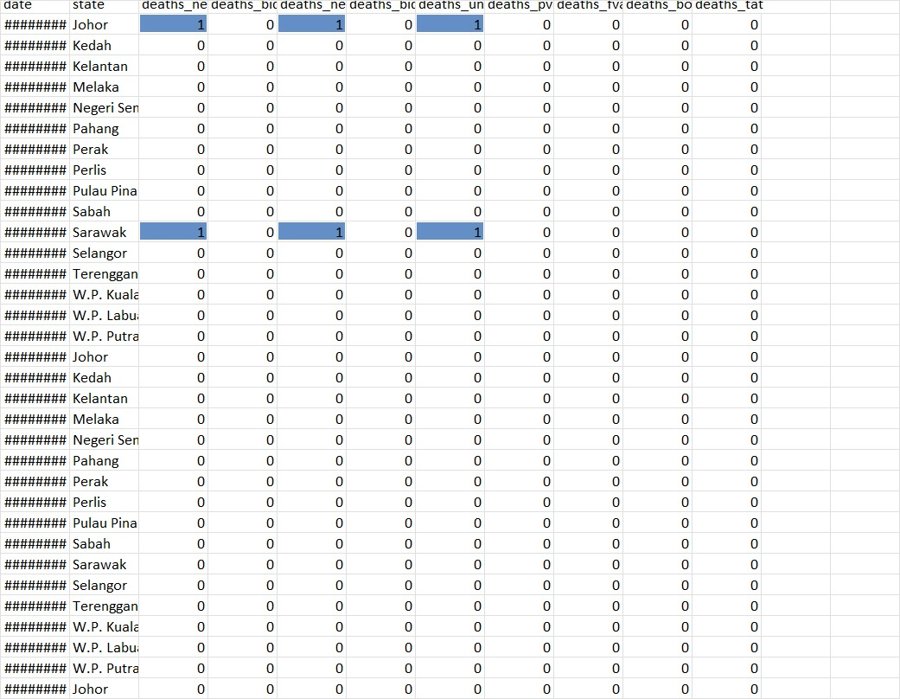

Slide 7

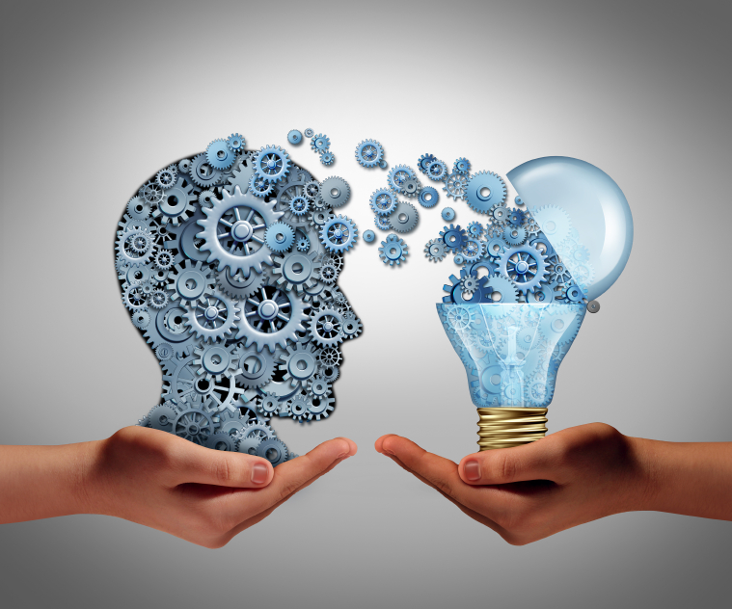
IMPLEMENTATION: 1.Supervised learning. 2.Parametric approach. 3.Classification. 4.Logistic regression. 5.Perceptron learning. 6.Support Vector Machine.
This Photo by Unknown Author is licensed under CC BY
1.

Slide 8
Logistic regression:
What is Logistic Regression? Logistic regression is a statistical method used to model the relationship between two variables by fitting a linear equation to the observed data. It is commonly used in data analysis to identify trends and patterns in the data, and to make predictions based on those trends.
For example, let's say you are analyzing the relationship between a person's age and their income. You could use linear regression to determine if there is a correlation between these two variables and to predict someone's income based on their age.
The equation for a simple linear regression model would be: Income = b0 + b1 * Age, where b0 is the intercept and b1 is the slope of the line . There are many different types of linear regression, including simple linear regression, multiple linear regression, and polynomial regression.
Each type is appropriate to use depending on the nature of the data and the research question being asked . Overall, linear regression is a powerful tool for analyzing data and making predictions. By understanding this concept, you can gain valuable insights into the relationships between variables and make informed decisions based on that knowledge.

Slide 9
APPLICATIONS OF LOGISTIC LEARNING:
Logistic regression is a powerful tool for data analysis that has a wide range of applications in real-world scenarios. One of the most common uses of logistic regression is in predicting customer churn. By analyzing customer data such as purchase history and demographics, logistic regression can help identify customers who are at risk of leaving and allow companies to take proactive measures to retain them.
Another important application of logistic regression is in identifying fraudulent activity. By analyzing patterns in financial transactions, logistic regression can help detect suspicious behavior and alert authorities before any significant damage is done. These are just a few examples of the many ways in which logistic regression can be used to gain insights and make informed decisions.

Slide 10
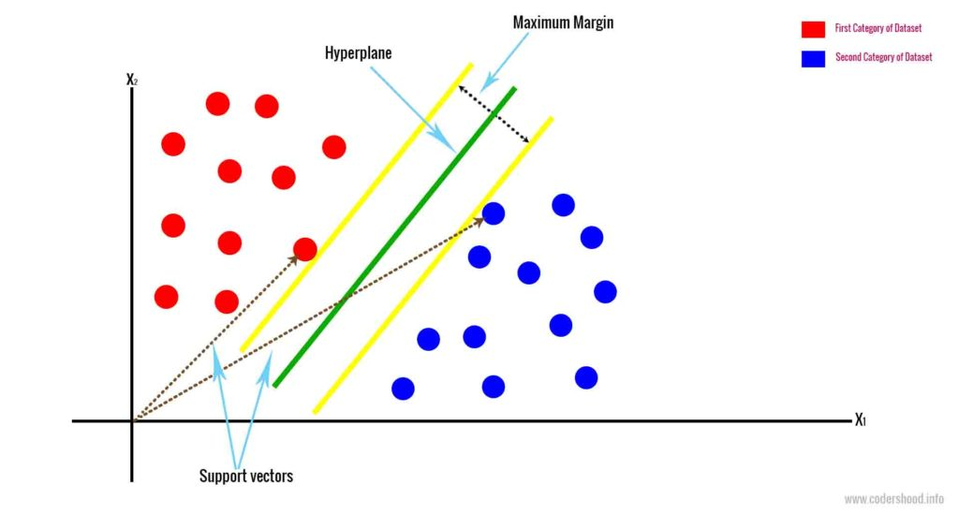
SUPPORT VECTOR MACHINE:
A support vector machine (SVM) is a type of supervised learning algorithm used in machine learning to solve classification and regression tasks; SVMs are particularly good at solving binary classification problems, which require classifying the elements of a data set into two groups.
The aim of a support vector machine algorithm is to find the best possible line, or decision boundary, that separates the data points of different data classes. This boundary is called a hyperplane when working in high-dimensional feature spaces. The idea is to maximize the margin, which is the distance between the hyperplane and the closest data points of each category, thus making it easy to distinguish data classes.

Slide 11
APPLICATIONS OF SUPPORT VECTOR MACHINE:
The aim of using SVM is to correctly classify unseen data. SVMs have a number of applications in several fields . Some common applications of SVM are-
Face detection – SVMc classify parts of the image as a face and non-face and create a square boundary around the face . Text and hypertext categorization – SVMs allow Text and hypertext categorization for both inductive and transductive models. They use training data to classify documents into different categories. It categorizes on the basis of the score generated and then compares with the threshold value.
Classification of images – Use of SVMs provides better search accuracy for image classification. It provides better accuracy in comparison to the traditional query-based searching techniques.
Bioinformatics – It includes protein classification and cancer classification. We use SVM for identifying the classification of genes, patients on the basis of genes and other biological problems.
Protein fold and remote homology detection – Apply SVM algorithms for protein remote homology detection . Handwriting recognition – We use SVMs to recognize handwritten characters used widely.
Generalized predictive control(GPC) – Use SVM based GPC to control chaotic dynamics with useful parameters.Let us now see the above applications of SVM in detail-2.1. Face Detection

Slide 12
ABOUT THE PERCEPTRON LEARNING:
Perceptron in Machine Learning The most commonly used term in Artificial Intelligence and Machine Learning (AIML) is Perceptron. It is the beginning step of learning coding and Deep Learning technologies, which consists of input values, scores, thresholds, and weights implementing logic gates. Perceptron is the nurturing step of an Artificial Neural Link. In 19h century, Mr. Frank Rosenblatt invented the Perceptron to perform specific high-level calculations to detect input data capabilities or business intelligence.
However, now it is used for various other purposes. History of PerceptronThe perceptron was introduced by Frank Rosenblatt in 1958, as a type of artificial neural network capable of learning and performing binary classification tasks. Rosenblatt was a psychologist and computer scientist who was interested in developing a machine that could learn and recognize patterns in data, inspired by the workings of the human brain.
The perceptron was based on the concept of a simple computational unit, which takes one or more inputs and produces a single output, modeled after the structure and function of a neuron in the brain. The perceptron was designed to be able to learn from examples and adjust its parameters to improve its accuracy in classifying new examples.
The perceptron algorithm was initially used to solve simple problems, such as recognizing handwritten characters, but it soon faced criticism due to its limited capacity to learn complex patterns and its inability to handle non-linearly separable data. These limitations led to the decline of research on perceptrons in the 1960s and 1970s.

Slide 13
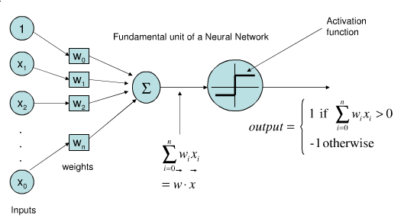
APPLICATIONS OF PERCEPTRON LEARNING:
Single layer perceptron:
It helps to organize the given input data. A perceptron is a neural network unit that does a precise computation to detect features in the input data. Perceptron is mainly used to classify the data into two parts. Therefore, it is also known as Linear Binary Classifier.
Multiple layer perceptron:
Multilayer Perceptrons are widely used to solve problems requiring supervised learning and research into computational neuroscience and parallel distributed processing. Examples include speech recognition, image recognition, and machine translation.

Slide 14
K-Nearest Neighbours
The k-nearest neighbors algorithm, also known as KNN or k-NN, is a non-parametric, supervised learning classifier, which uses proximity to make classifications or predictions about the grouping of an individual data point. While it can be used for either regression or classification problems, it is typically used as a classification algorithm, working off the assumption that similar points can be found near one another . For classification problems, a class label is assigned on the basis of a majority vote—i.e. the label that is most frequently represented around a given data point is used. While this is technically considered “plurality voting”, the term, “majority vote” is more commonly used in literature. The distinction between these terminologies is that “majority voting” technically requires a majority of greater than 50%, which primarily works when there are only two categories.

Slide 15
APPLICATIONS OF KNN
principal Component Analysis (PCA) is a statistical procedure that uses an orthogonal transformation that converts a set of correlated variables to a set of uncorrelated variables . PCA is the most widely used tool in exploratory data analysis and in machine learning for predictive models. Moreover, Principal Component Analysis (PCA) is an unsupervised learning algorithm technique used to examine the interrelations among a set of variables. It is also known as a general factor analysis where regression determines a line of best fit. The main goal of Principal Component Analysis (PCA) is to reduce the dimensionality of a dataset while preserving the most important patterns or relationships between the variables without any prior knowledge of the target variables. Principal Component Analysis (PCA) is used to reduce the dimensionality of a data set by finding a new set of variables, smaller than the original set of variables, retaining most of the sample’s information, and useful for the regression and classification of data.

Slide 16
BOOTSTAPPING
In statistics and machine learning, bootstrapping is a resampling technique that involves repeatedly drawing samples from our source data with replacement, often to estimate a population parameter. By “with replacement”, we mean that the same data point may be included in our resampled dataset multiple times . The term originates from the impossible idea of lifting ourselves up without external help, by pulling on our own bootstraps. Side note, but apparently it’s also why we “boot” up a computer (to run software, software must first be run, so we bootstrap).Typically our source data is only a small sample of the ground truth. Bootstrapping is loosely based on the law of large numbers, which says that with enough data the empirical distribution will be a good approximation of the true distribution . Using bootstrapping, we can generate a distribution of estimates, rather than a single point estimate. The distribution gives us information about certainty, or the lack of it.

Slide 17
APPLICATIONS OF BOOTSTAPING
Bootstrap makes responsive web design a reality. It makes it possible for a web page or app to detect the visitor's screen size and orientation and automatically adapt the display accordingly. The mobile-first approach assumes smartphones, tablets and task-specific mobile apps are employees' primary tools for getting work done. Bootstrap addresses the requirements of those technologies in design and includes UI components, layouts, JavaScript tools and the implementation framework. The software is available precompiled or as source code . Mark Otto and Jacob Thornton developed Bootstrap at Twitter to improve the consistency of tools used on the site and to reduce maintenance. The software was formerly known as Twitter Blueprint and is sometimes referred to as Twitter Bootstrap.

Slide 18
PRINICIPAL COMPONENT ANALYSIS
In statistics and machine learning, bootstrapping is a resampling technique that involves repeatedly drawing samples from our source data with replacement, often to estimate a population parameter. By “with replacement”, we mean that the same data point may be included in our resampled dataset multiple times . The term originates from the impossible idea of lifting ourselves up without external help, by pulling on our own bootstraps. Side note, but apparently it’s also why we “boot” up a computer (to run software, software must first be run, so we bootstrap).Typically our source data is only a small sample of the ground truth. Bootstrapping is loosely based on the law of large numbers, which says that with enough data the empirical distribution will be a good approximation of the true distribution . Using bootstrapping, we can generate a distribution of estimates, rather than a single point estimate. The distribution gives us information about certainty, or the lack of it.

Slide 19
APPLICATIONS OF PCA
PCA is used to visualize multidimensional data.
PCA can help resize an image.
It is used to reduce the number of dimensions in healthcare data.
It can be used in finance to analyze stock data and forecast returns.
PCA helps to find patterns in the high-dimensional datasets.

Slide 20
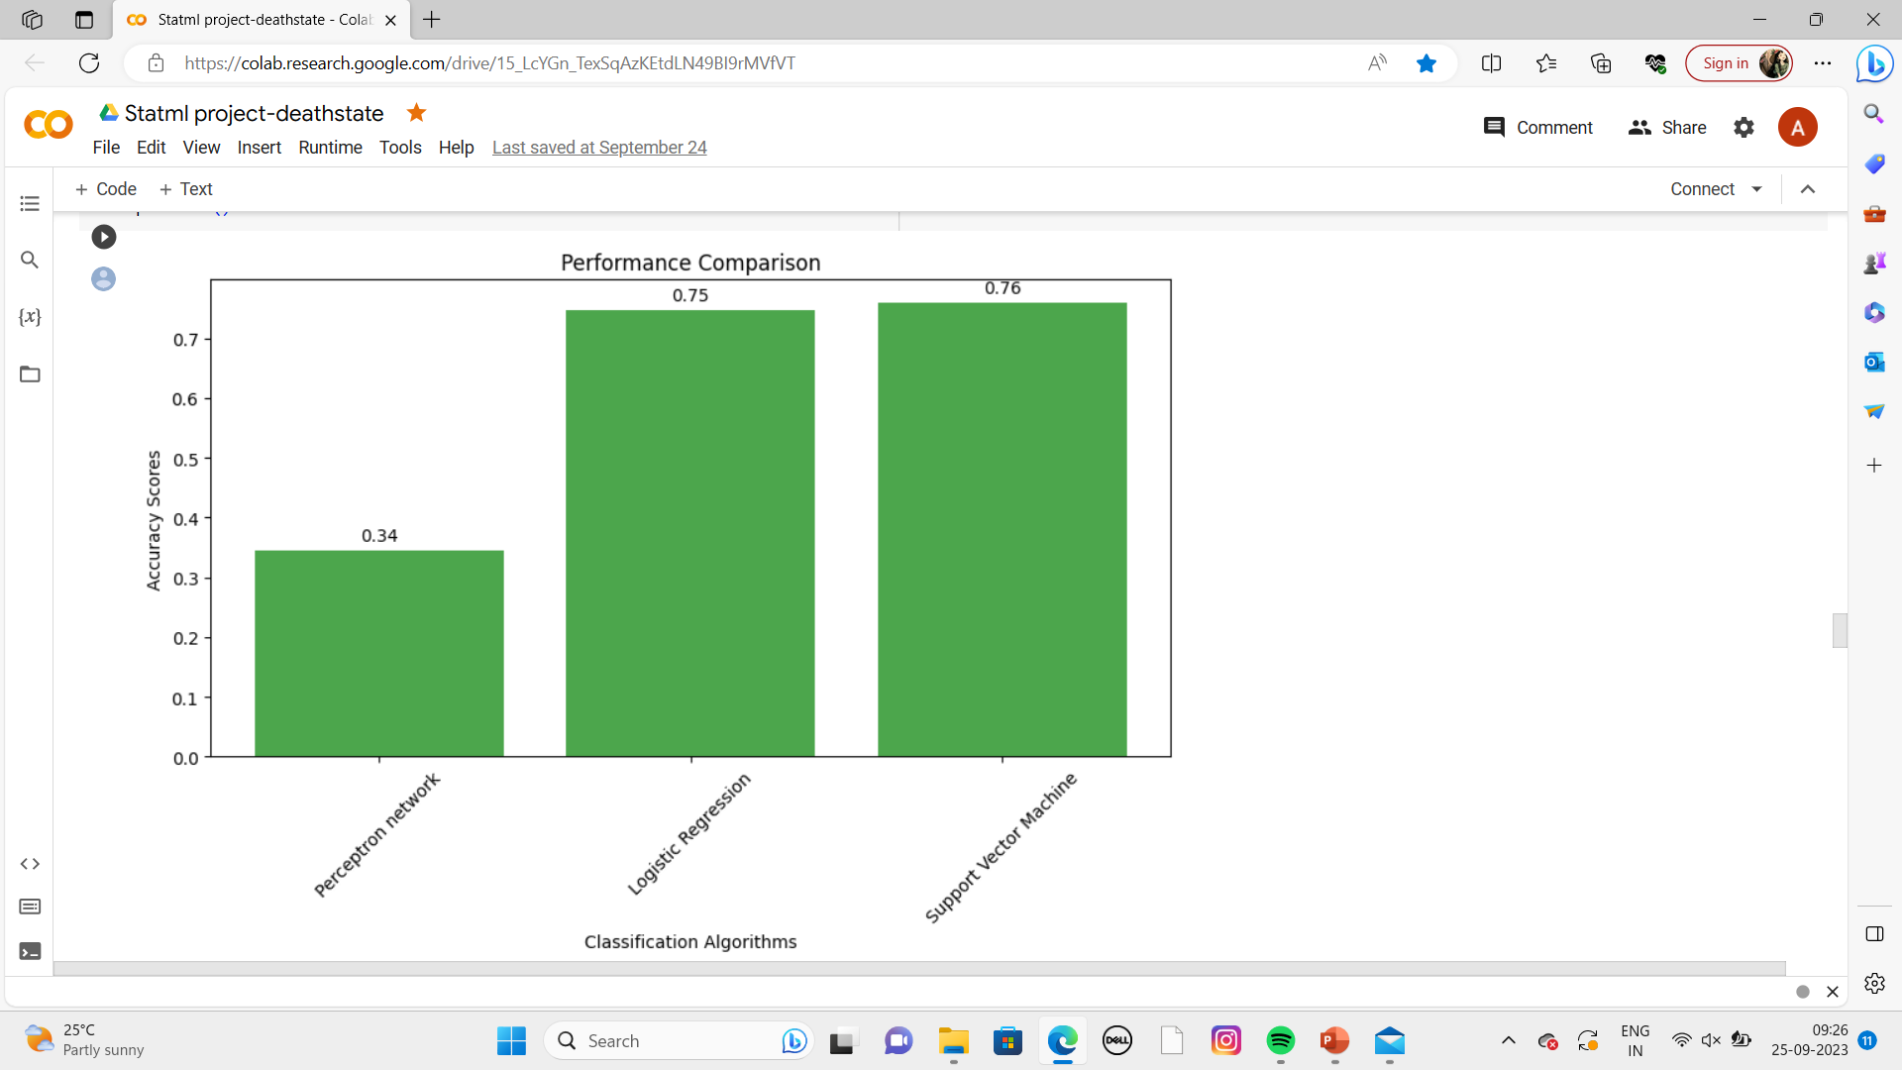
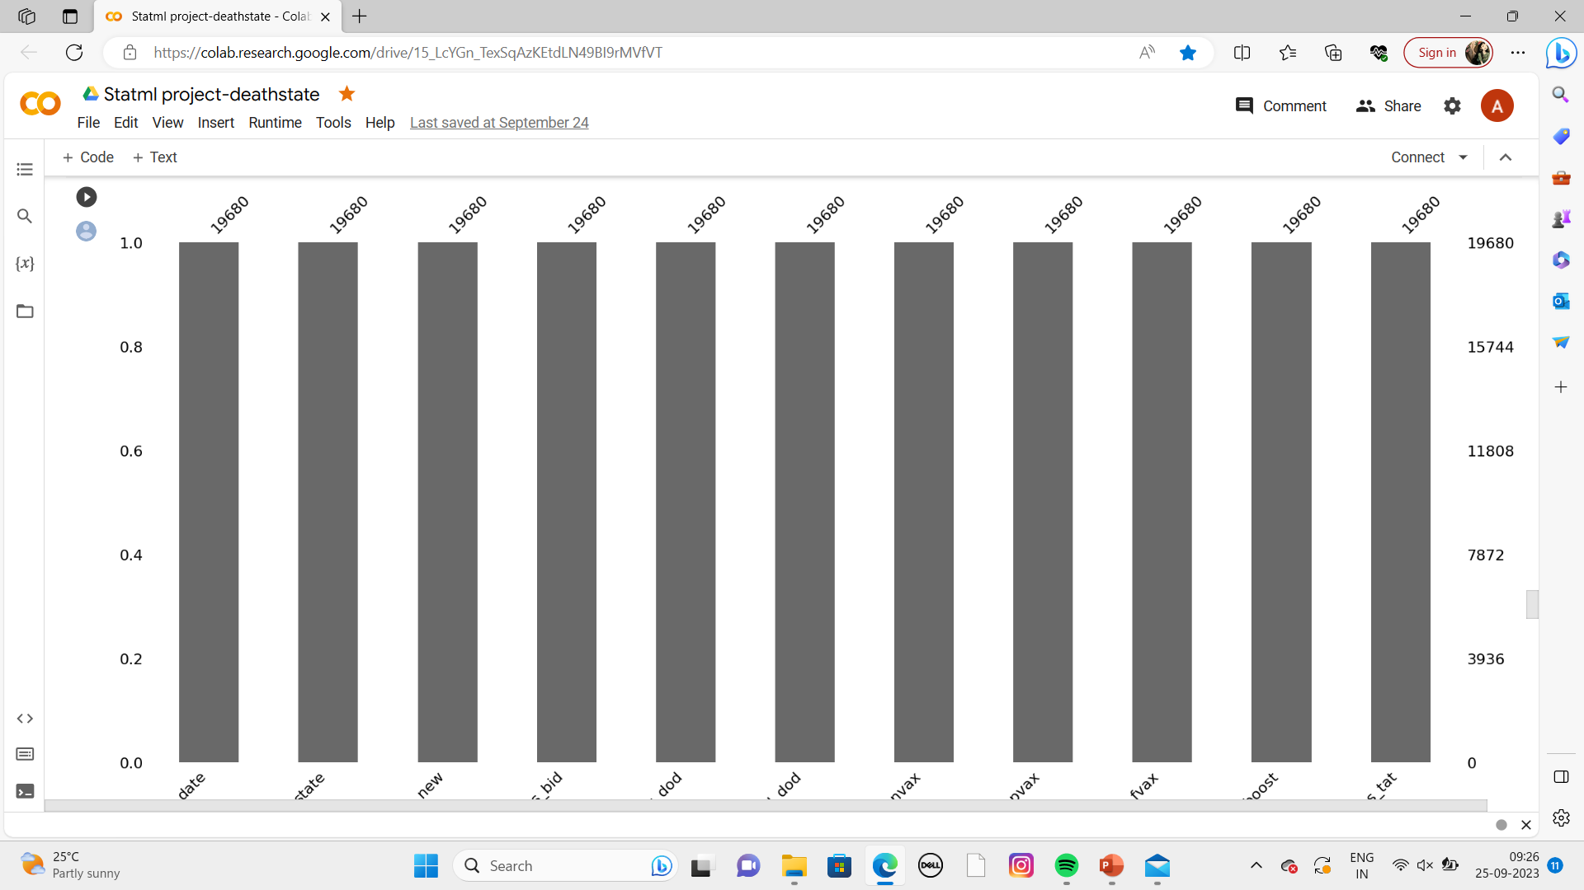
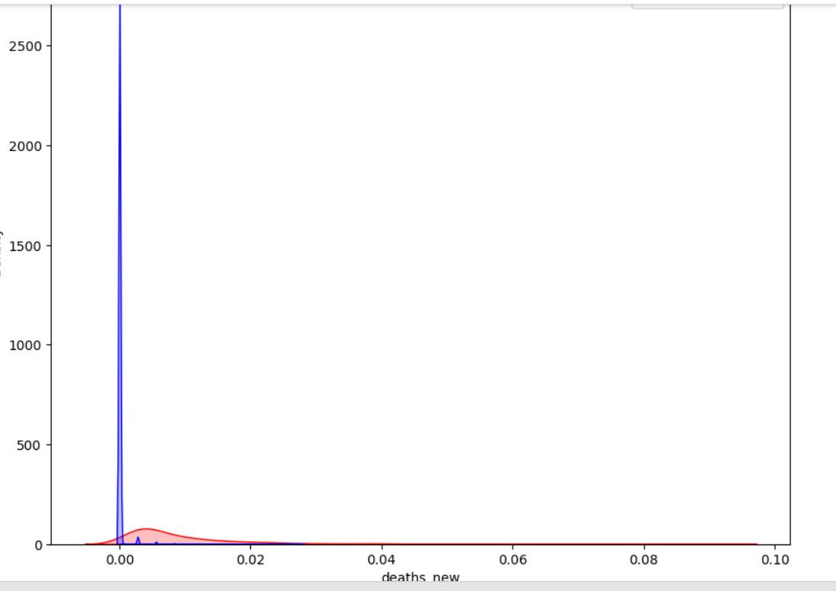
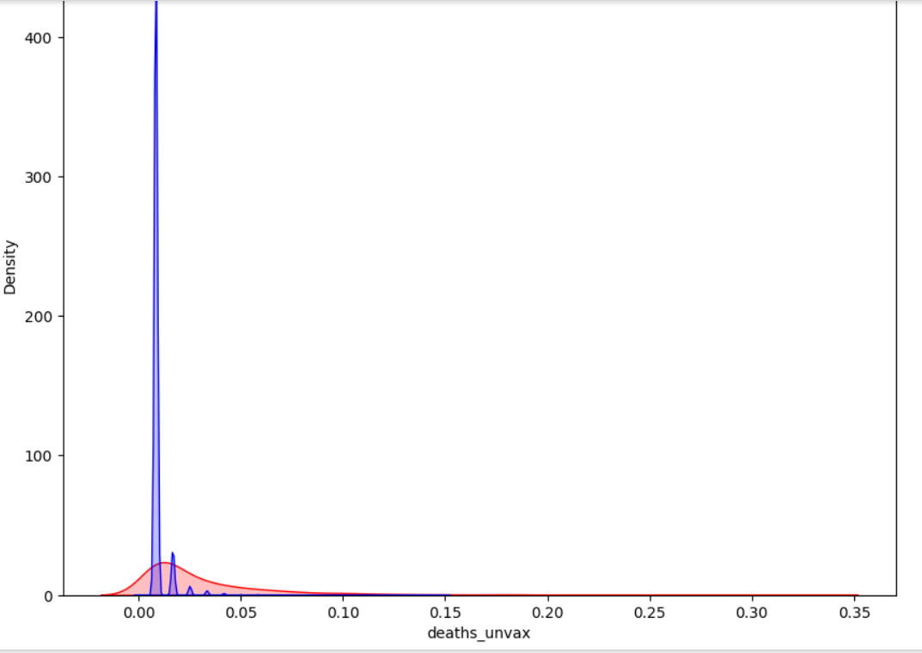
GRAPHS:

Slide 21
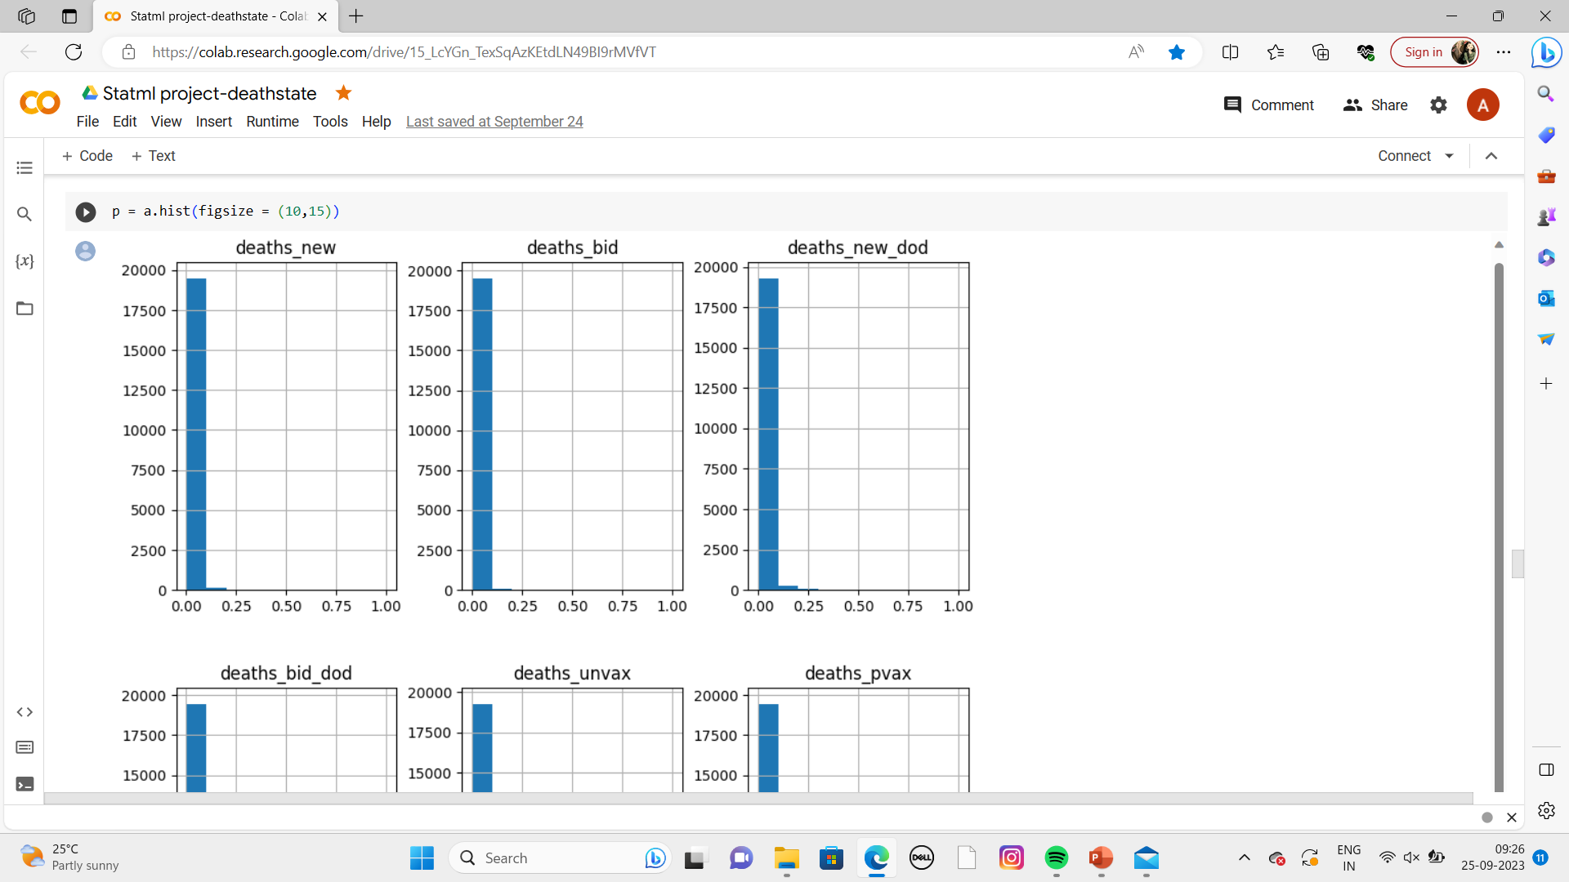
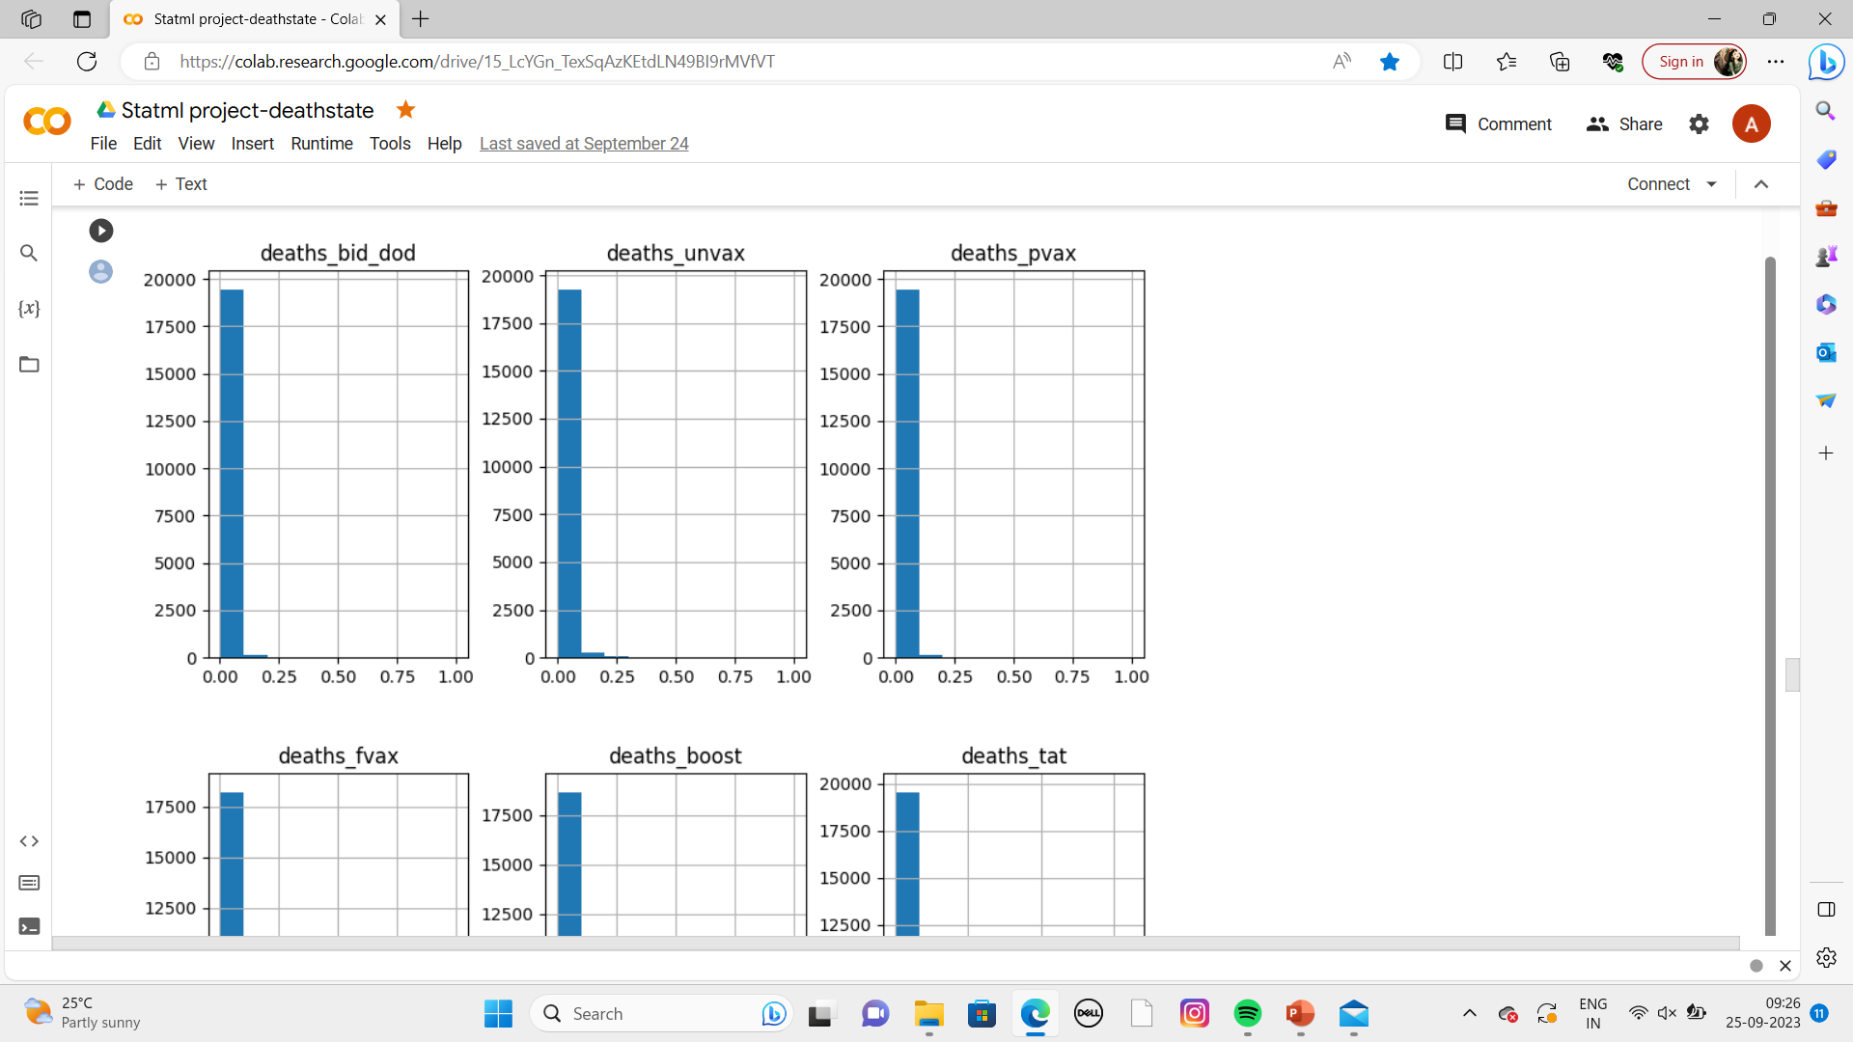
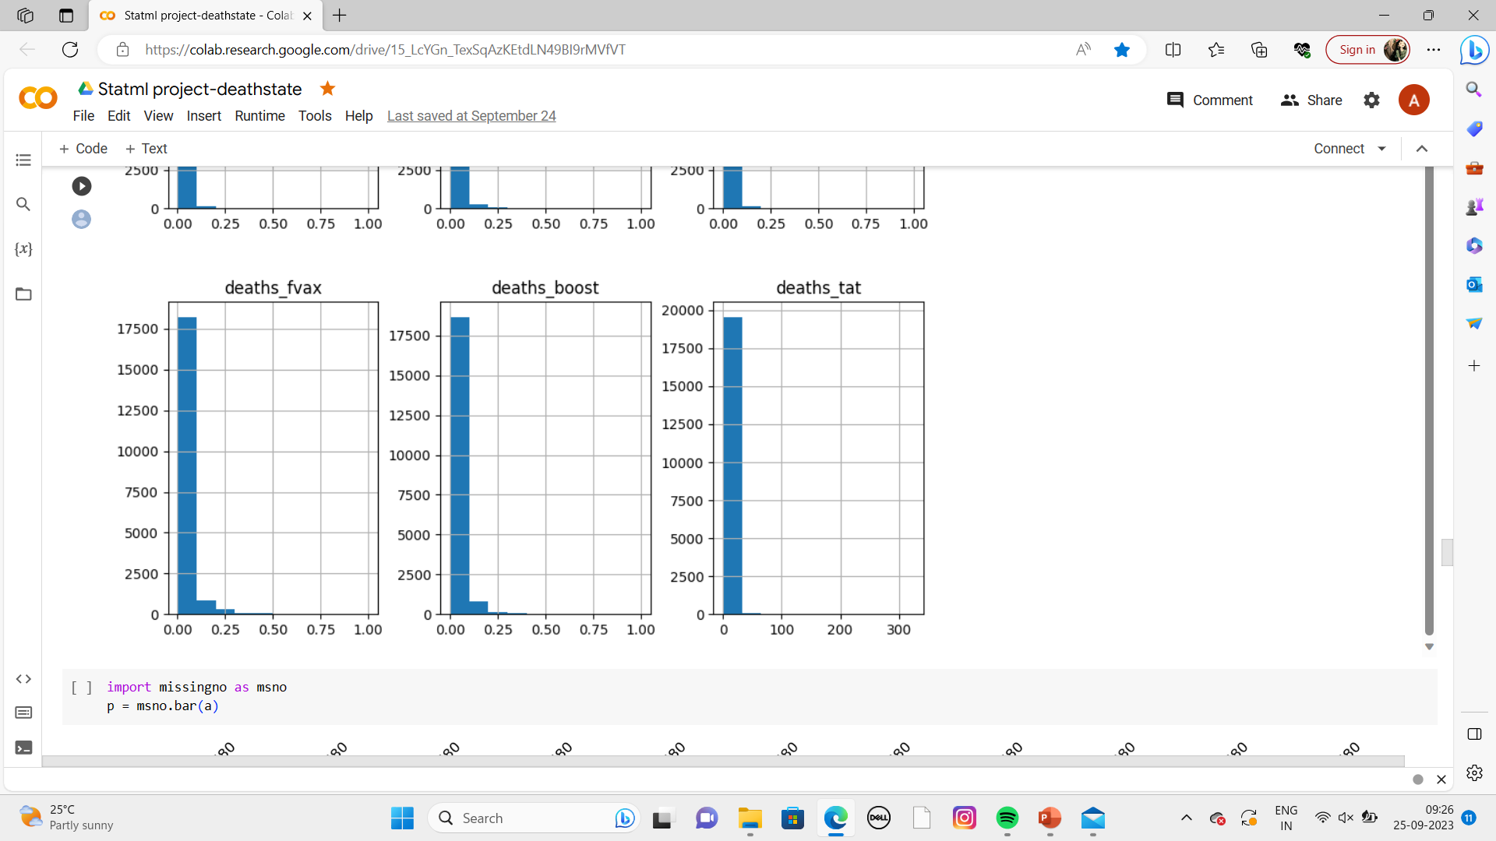
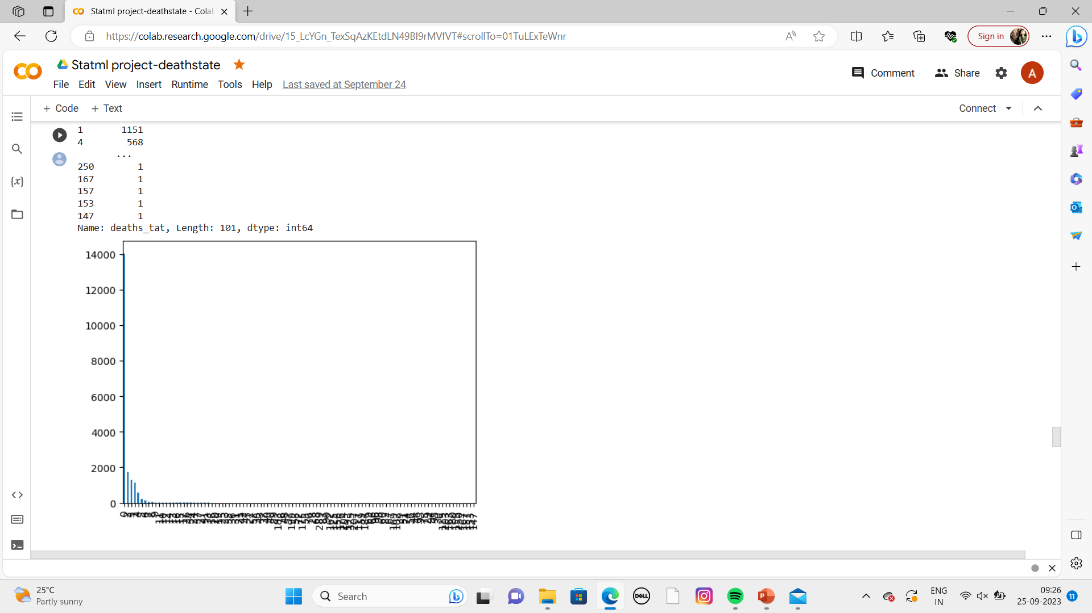
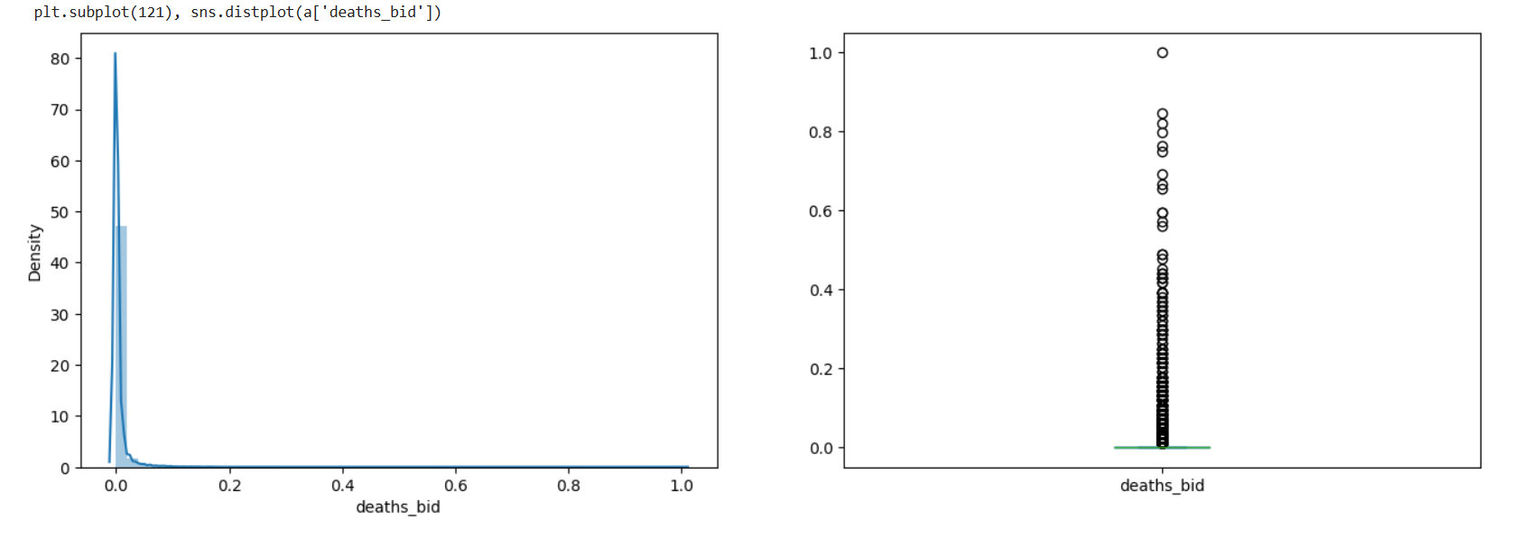

Slide 22
CONCLUSION:
Malaysia's COVID-19 case fatality rate is lower than what it is globally; this is due to the successful implementation of early preparedness and planning, the public health and hospital system, comprehensive contact tracing, active case detection, and a strict enhanced MCO.
COVID-19 pandemic is the greatest communicable disease outbreak to have hit Malaysia since the 1918 Spanish Flu which killed 34,644 people or 1% of the population of the then British Malaya. In 1999, the Nipah virus outbreak killed 105 Malaysians, while the SARS outbreak of 2003 claimed only 2 lives. The ongoing COVID-19 pandemic has so far claimed over 100 Malaysian lives. There were two waves of the COVID-19 cases in Malaysia.

Slide 23
GITHUB LINK:
https://github.com/Vadijevishishta/2203a52186_capstone_project.git

Slide 24



